Slide 1
eSkills.net
LANGUAGE e-Learning platforms

Slide 2
Our products
English
French
Spanish
German
Italian
Russian
Dutch
Brazilian
Portugese
yLynks DIY elearning
Coming soon Arabic Chinese Each language 6,000 pages

Slide 3
Corporate solutions
Certified exams
Complete training structures
Employment agencies
Language schools
Recruiting (level tests)
Complete solutions
GDPR compliant 2021
yLynks Do It Yourself elearning
Competitive pricing

Slide 4
Extranet (administrator) Human resources Tutors Companies Real time follow up

Slide 5
Personalized Tracking Time on site Strengths / weaknesses Evaluations Progress Tutors Etc…

Slide 6
Details (hours of connection, time on site etc...)

Slide 7
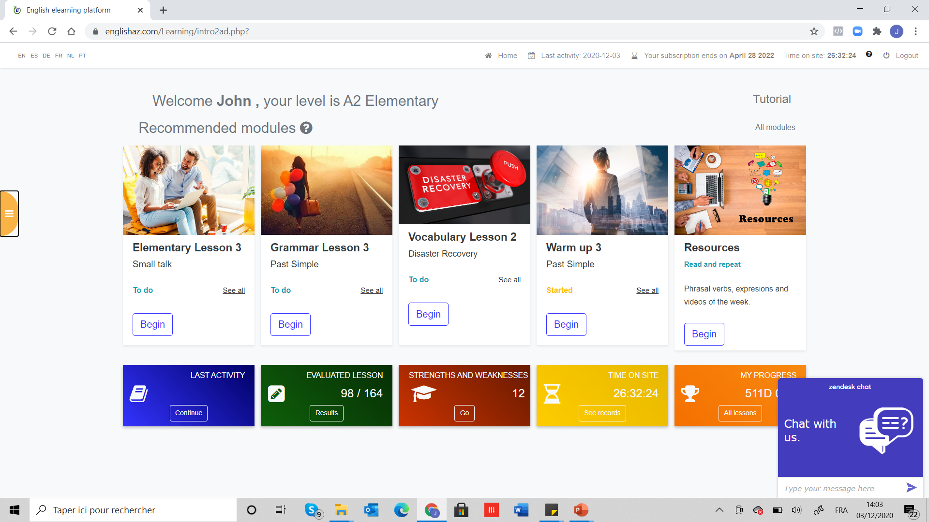
Fun! 200+ Videos MP3s Evaluations eAccent eDictation Chat Support and teachers)

Slide 8
Testing (entrance/progress/exit)

Slide 9
Quality control

Slide 10
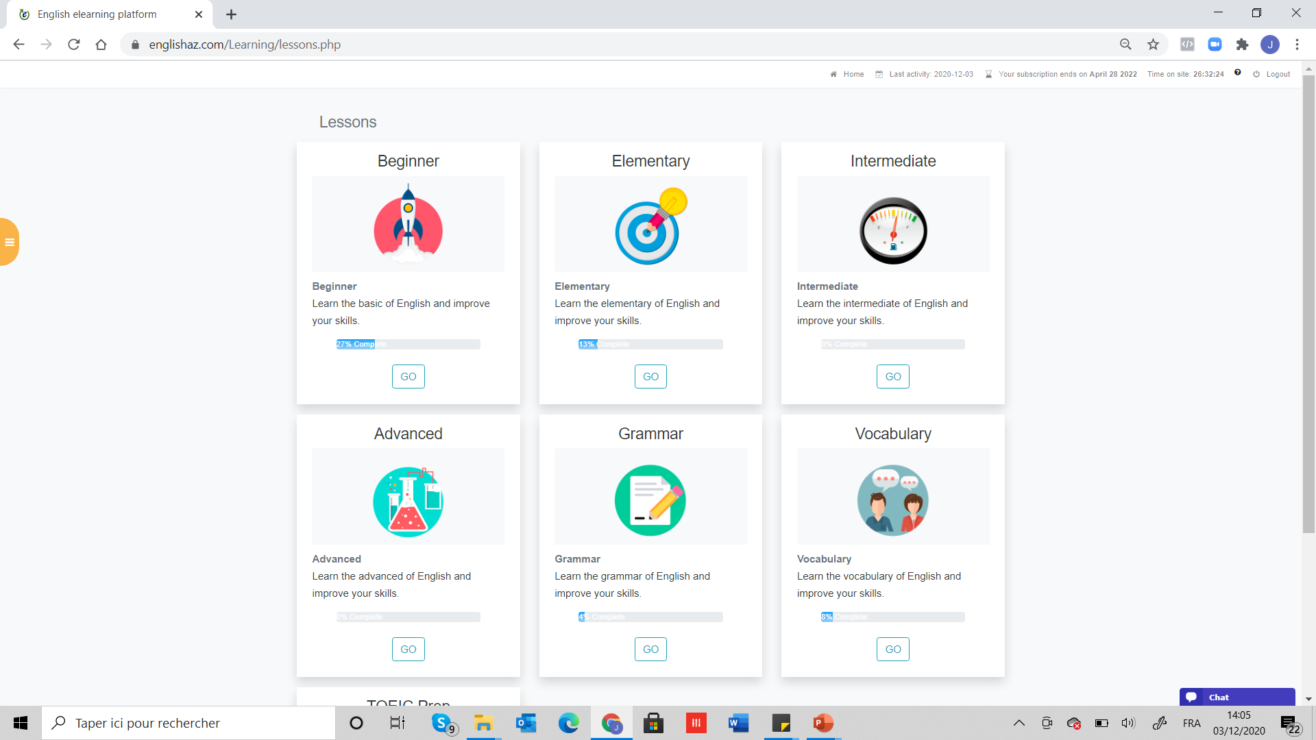
Lessons (for all languages) 4 levels Grammar Vocabulary /expressions Conversation Preparation TOEIC DELF TOEFL IELT BRIGHT TEF DELE TCF …

Slide 11
My progress (Students) My level Time on site Last activity Personalized help

Slide 12
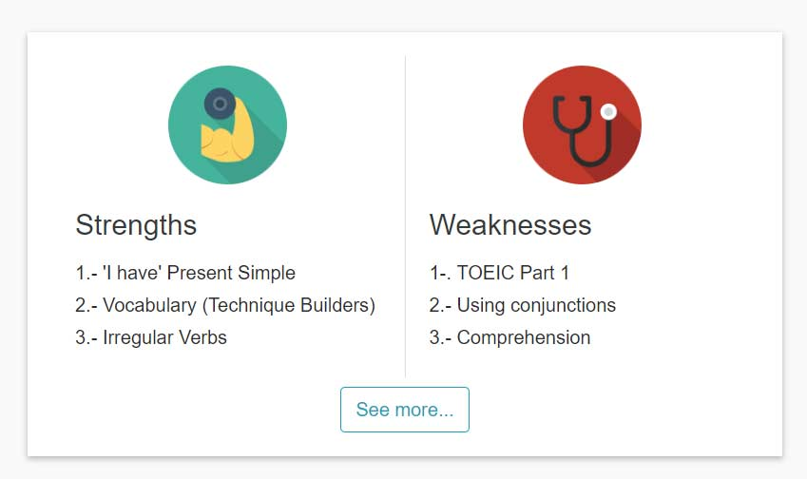
Strengths Weaknesses For the student For the teacher For efficiency

Slide 13
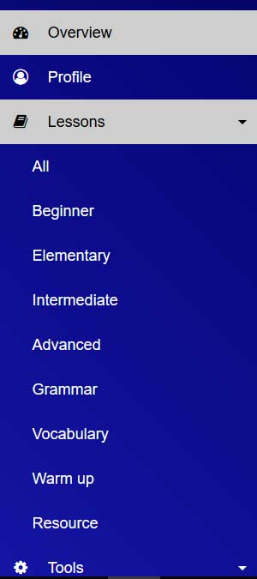
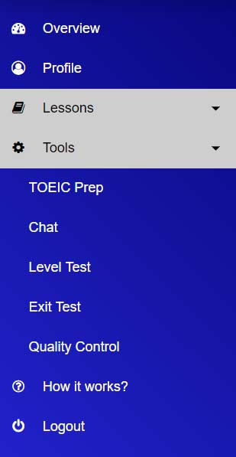
Program Videos Coach access Level tests Smart phone activities eAccent eDictation Vocabulary Grammar All levels

Slide 14
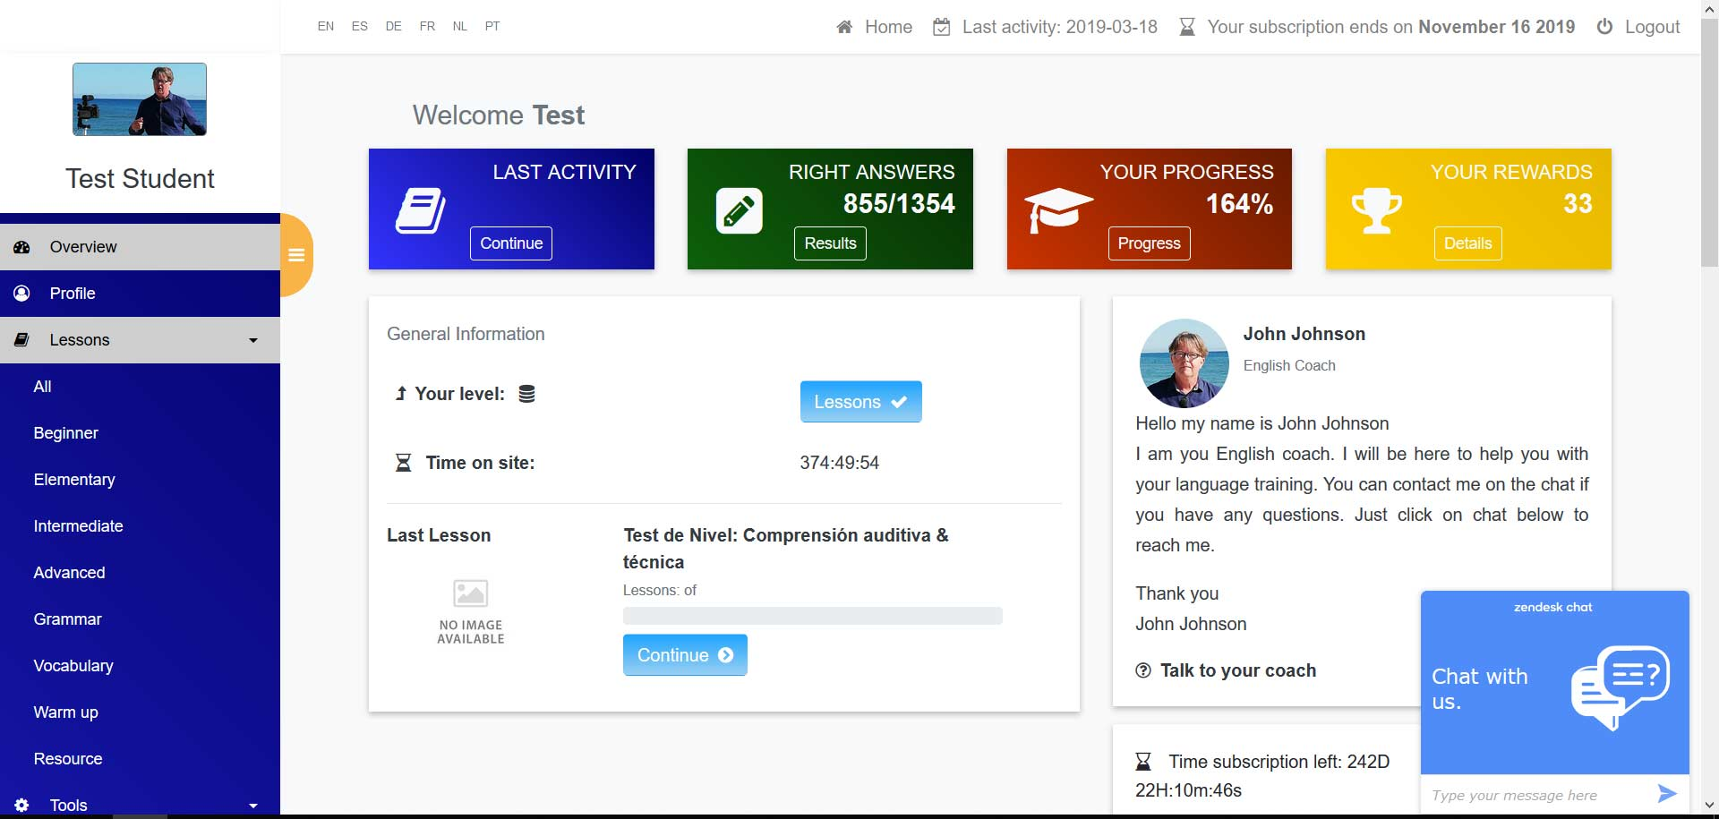
Personnalisation (AI Artificiel Intelligence)

Slide 15
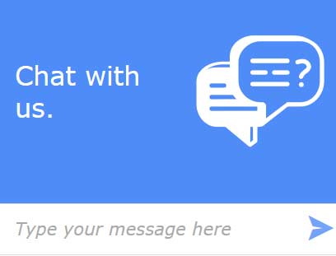
Your coach Native speakers Available 7 am / 11 pm Technical help Functional help Pedagogical help

Slide 16
Speaking (Accent work) eAccent ®

Slide 17
Writing eAccent ®

Slide 18
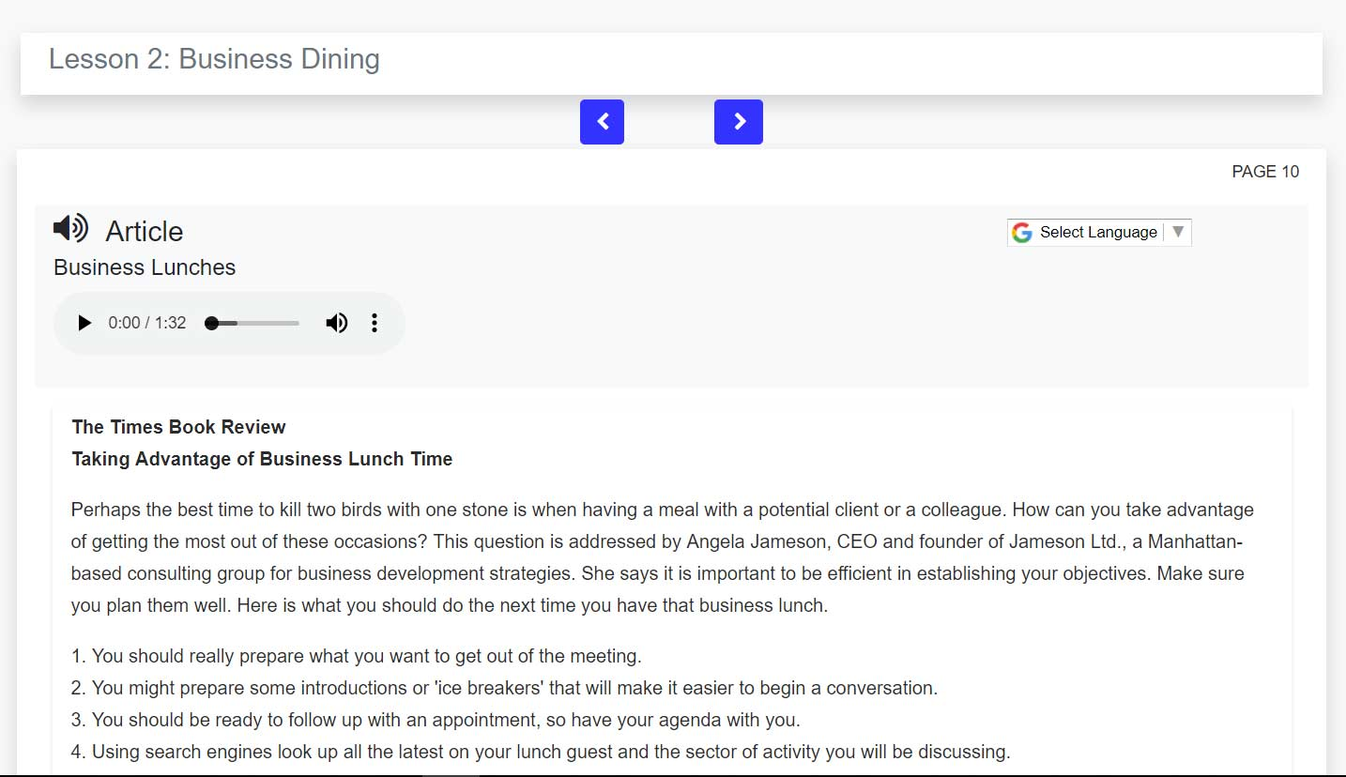
Listening Speaking Reading Translaiton

Slide 19
Format 1) E-learning 2) Blended / coaches

Slide 20
yLynks.com Do It Yourself elearning

Slide 21
Compatible all devices Smartphone, PC and Mac

Slide 22
Contact us info@eskills.net +33 9 70 40 50 51 France +1 954 317 1986 USA Canada +56 2 979 8290 Mexico South America +27 1108 38837 South Africa

